Slide 1
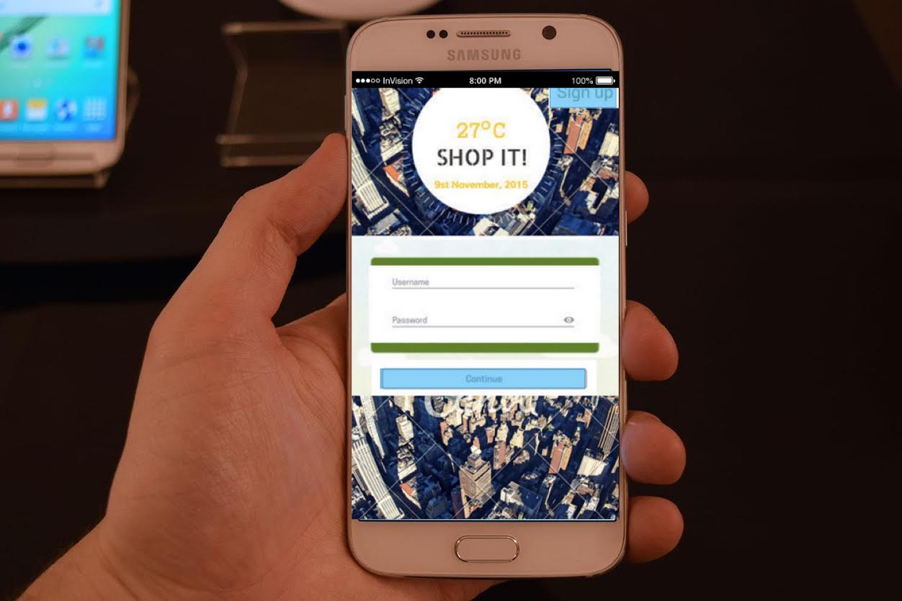
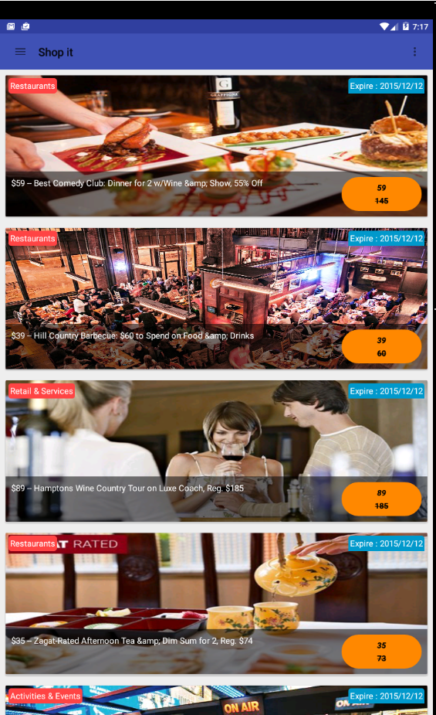
CS9223 Cloud Computing
NYU School of Engineering
Professor:
Sambit Sahu
SHOP IT!
Presented By:
Ashish Tyagi
Nitin Wagadia
Shailesh Chaudhary
Abhishek Sharma

Slide 2
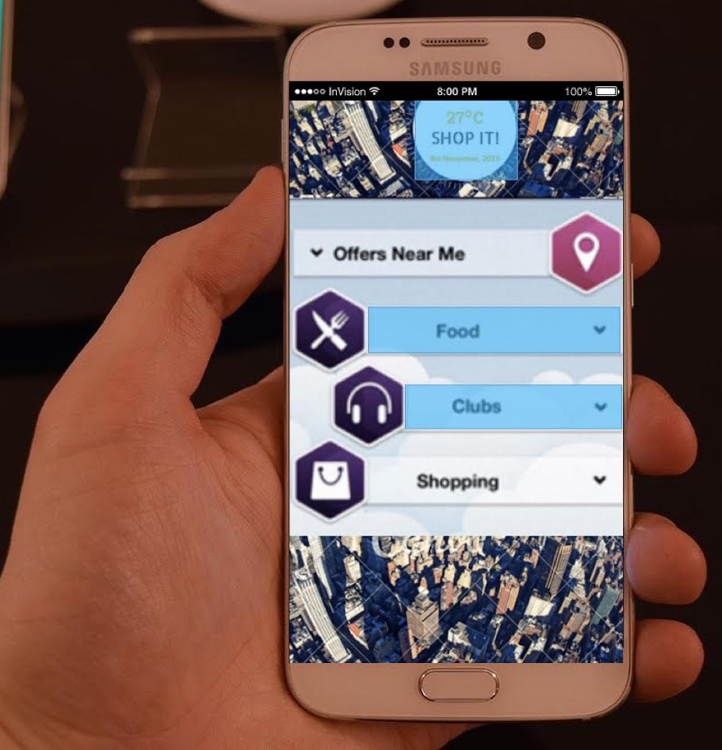
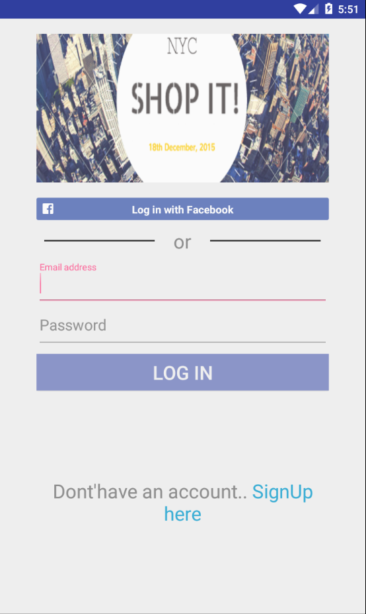
Project Background
Cloud based Mobile application
Enhancing the shopping experience
Recommends best offers in nearby stores, deals in restaurants and best discounts on products
Uses Amazon services for high availability
REST API provides responses from backend elastic search engine
Geocoded deals data ensuring minimum response time for users.
Client can become a MERCHANT and start own business.

Slide 3
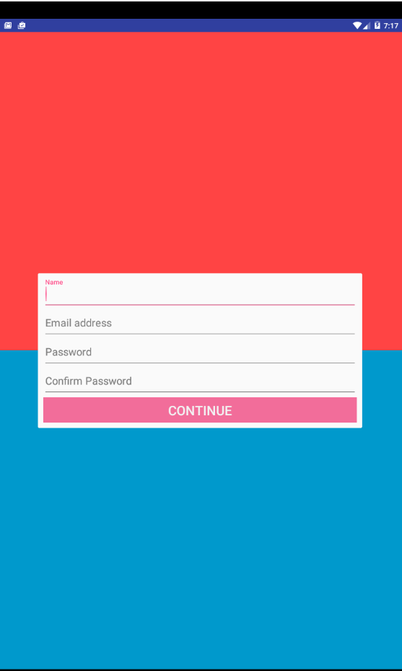
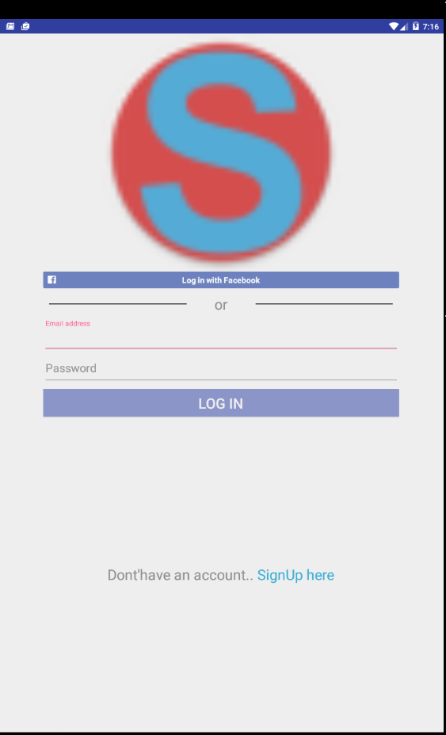
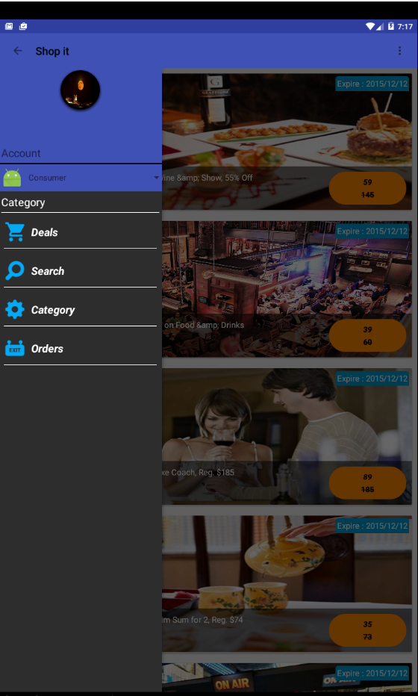
Project highlights
Android App
REST API
GCM
ELASTIC SEARCH

Slide 4
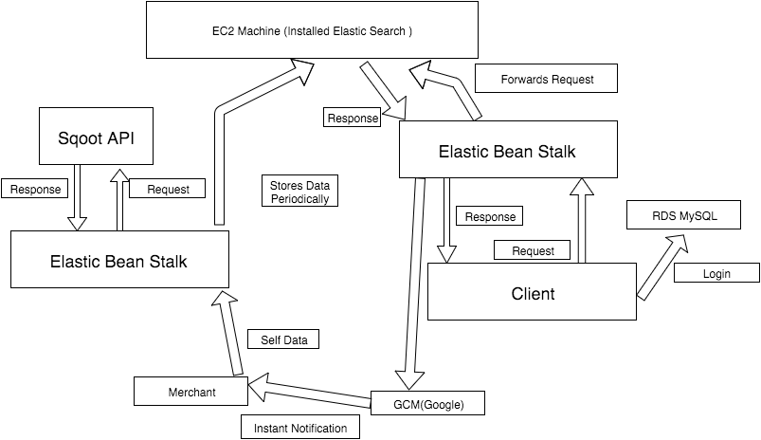
Architecture

Slide 5

Android App

Slide 6
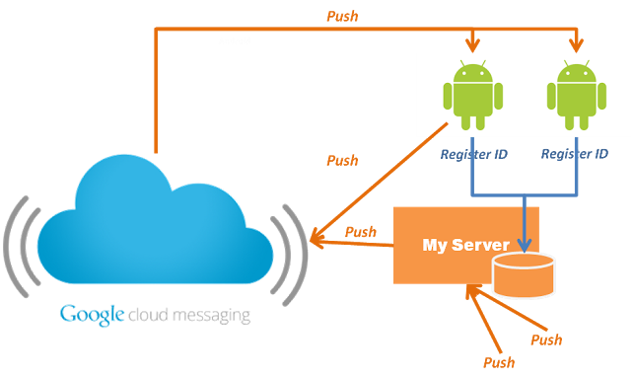
GCM

Slide 7



REST API

Slide 8




Elastic Search

Slide 9

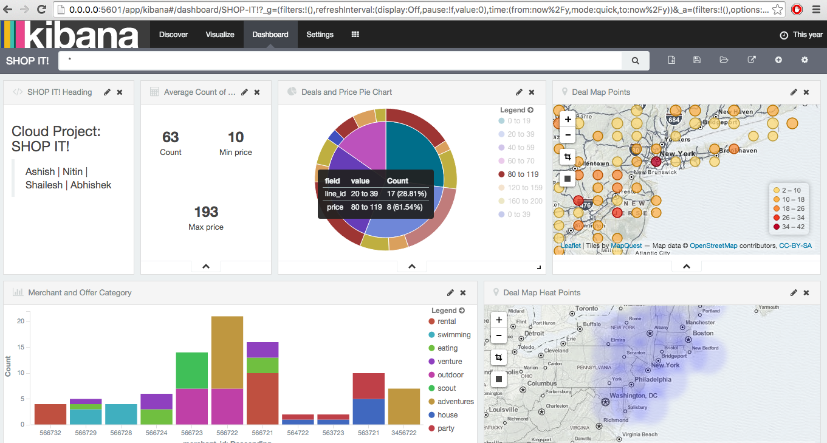
Data Analysis Kibana

Slide 10
DEMO

Slide 11
Thank You
Q&A

